Slide 1

Apprentice to Master: Tech Lead and Beyond…Drink Your Milk and Cookies!
Monte Raymond
Insert QR Code

Slide 2

Welcome
Thank you for supporting your local code camp/conference!
Thank you to our Veterans!

Slide 3
Who Am I and Disclaimers
Who Am I?
Disclaimer…as a beginner, this can be good for your career
or those that you supervise or other personal/outside needs
Other disclaimers…

Slide 4

Objectives
Identify the “why” of expanding tech leadership
Identify common tech skills
Define your leadership
Understand soft skills
Identify sample methods of developing

Slide 5
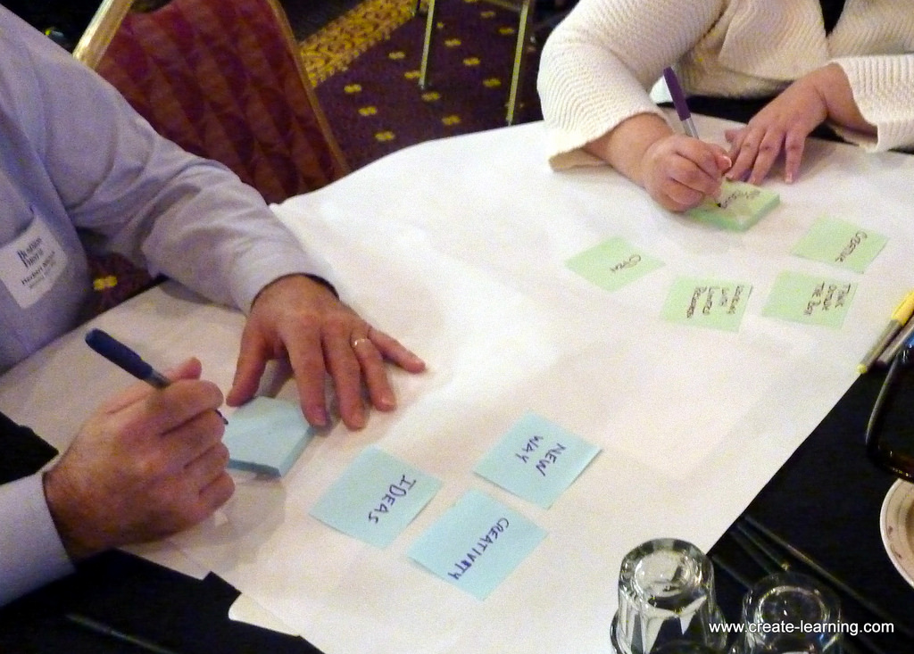
Tech Lead – Why Important
Role or position
Sample Functions
Entire Software Life Cycle
Big Picture
Career Bridge: Beginner
Mixture/Recipe of multiple perspectives

Slide 6
Let’s Take a Look
What is your focus?
What did you see or NOT see?
You don’t see what you are looking for unless known or pointed out

Slide 7

Leadership
How do you define leadership?
Joeseph Rost – Analyzed and found 221 definitions of leadership

Slide 8

Technical Knowledge
Multiple Technologies with depth
Different components fit together
Balance responsibilities
Communication/Translation (know your audience)
Here’s your MILK!

Slide 9
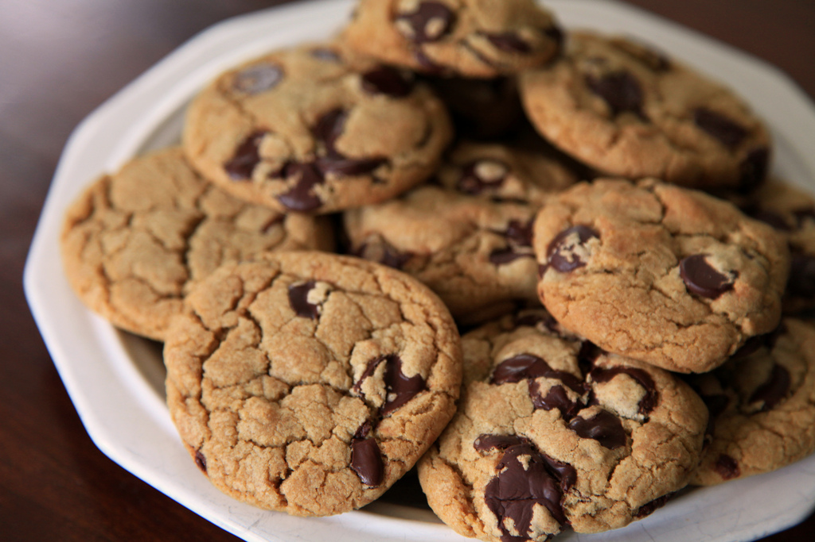
Sample Other Skills
Communication
Relationships
Accountability
Motivation
Results vs How
Evaluation
Emotional Intelligence
Mentoring
Here’s your COOKIES!

Slide 10

How To Do
Attending user groups, code camps, meetups
Mentoring others
Be a mentee
Start engaging in people leadership skills
Build genuine relationships
Build career with legos (build steps, don’t leap)

Slide 11
How To Do…Some More…
Do the job/role before you get the job/role
Take classes
Understand how to navigate conflict, political aspects
Focus on concepts (transportable throughout career)
Grow leadership and your brand

Slide 12
Sample Pitfalls
Playing favorites
All coder
Looking the other way
Old crowd, new role
Person not ready
This Photo by Unknown Author is licensed under CC BY-SA

Slide 13
Wrap-up
Find/define/grow your leadership
Keep your base
Think and act differently
Find a mentor and reflect
Drink your milk (technical foundation) and cookies (sweeten for differences of your approach)! It makes it a great start to your career!
What is your next step?

Slide 14

Thank you!
+
= Good Stuff
Here’s your MILK!
Here’s your COOKIES!

Slide 15
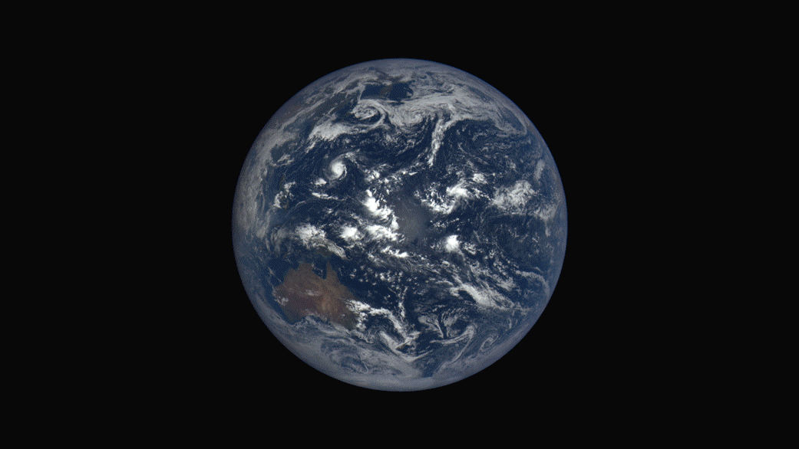
Extra…Extra….Extra….Extra…Extra…Extra…
Post Beginner Leadership….Future sessions
Organizational leadership frameworks
IT and Business strategy, vision, mission
Career development
Culture
Diversity
People leadership
Goals
Continuous Improvement
Personality
Holistic awareness
Work/life balance
Performance management
Team formation

Slide 16
References
Pictures
Objectives. CC BY-SA 3.0 Nick Youngson. Nick Youngson - link to - http://nyphotographic.com/.
Flag. American-flag-2a.jpg. CC-BY-SA-3.0.Harris.news. https://commons.wikimedia.org/wiki/File:American-flag-2a.jpg
Creative Learning. Michael Cardus. Attribution 2.0 Generic (CC BY 2.0). https://www.flickr.com/photos/create-learning/10982967824.
Future of Leadership. Shiv2601. Creative Commons Attribution-Share Alike 3.0 Unported https://commons.wikimedia.org/wiki/File:Future_of_leadership_Initial_banner1.jpg.
Cat, milk, teacup. Haidi2002. Free for commercial use. https://pixabay.com/en/cat-milk-teacup-persian-language-1027486/
Best cookie ever. April. Attribution 2.0 Generic (CC BY 2.0). https://www.flickr.com/photos/rottnapples/5778822316.
System, network, news, personal. Geralt. Free for commercial use. https://pixabay.com/en/system-network-news-personal-571182/.
Earth. Earth-EpicDay260-20150917.gif. NASA. PD-USGov. Public Domain. http://www.nasa.gov/press-release/daily-views-of-earth-available-on-new-nasa-website.
Pitfall. Activison. CC BY-SA 3.0. https://upload.wikimedia.org/wikipedia/en/thumb/0/06/Pitfall%21_Coverart.png/220px-Pitfall%21_Coverart.png .
Video
Simmons & Chabris (1999). https://www.youtube.com/watch?v=vJG698U2Mvo
Research
Rost, J. C. (1991). Leadership for the Twenty-First Century. New York: Praeger Publishers.

Slide 17
Apprentice to Master: Tech Lead and Beyond…Drink Your Milk and Cookies!
Monte Raymond
Insert QR Code

